Slide 1
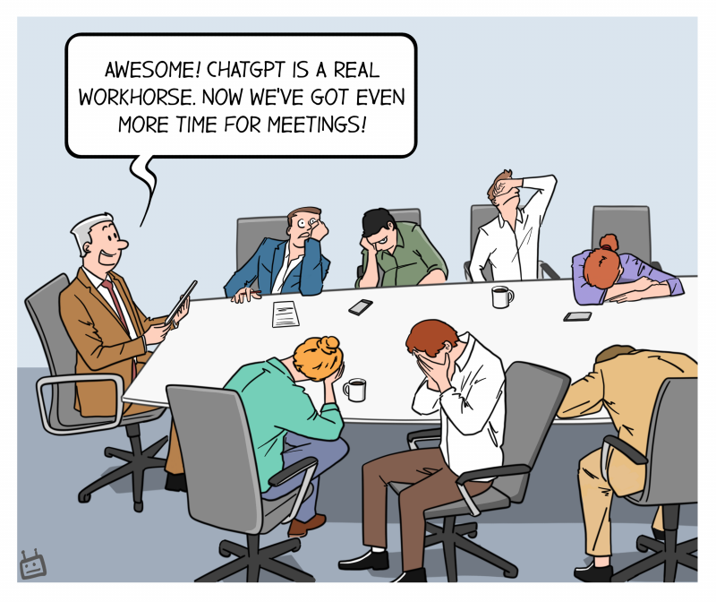
Getting your hands dirty: Exploring Exploits with ChatGPT
Cloud Security Alliance - Colorado Chapter Meetup
Presenter: Blake Lohn-Wiley
Notes:
Good evening everyone, and welcome to our session on 'Exploring Exploits with ChatGPT'! Today, we gather here at the Flat Irons School, downtown Denver, to dive into the fascinating world of cybersecurity and artificial intelligence.

Slide 2






Who Am I?
Roles: Solutions Architect, Software Engineer, Data Scientist
Education: I hold a MS degree in Applied Mathematics and a BS in Mathematics.
Impact: Significant contributions across various organizations.
Algorithm design, software optimization, data-driven solutions, cybersecurity education.
Current: Driving innovation in cybersecurity at Revelstoke Security.
Notes:
My name is Blake and I have been working in the field of cybersecurity for several years. Throughout my career, I've witnessed the evolution of cybersecurity threats and the rise of AI as a tool to combat them. Today, I'm excited to share my knowledge with you and explore how ChatGPT can be used in this context.

Slide 3
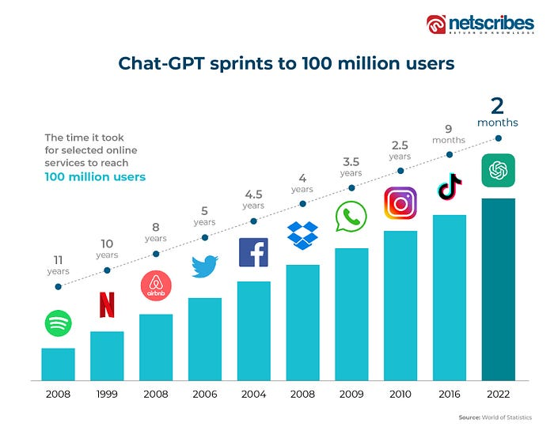
What is ChatGPT?
How did we get here?
Explanation of ChatGPT
ChatGPT as a cybersecurity
tool
Notes:
ChatGPT reached 100 million users swiftly due to its exceptional conversational abilities, continuous learning, democratized access, versatility, user-friendly integration, and reliable performance. T
These factors set it apart from other technologies and drove widespread adoption across diverse domains.
ChatGPT is a powerful language model developed by OpenAI. It's based on the GPT series of models, designed to generate human-like text based on the context and input they receive.
In the realm of cybersecurity, ChatGPT can serve as an invaluable tool, providing resources on cybersecurity topics, assisting in analyzing cyber threats, and offering insights into security vulnerabilities, among other things.

Slide 4

Goals of Today's Session
Communicate key takeaways about AI's role in cybersecurity and ChatGPT's utilization.
Showcase ChatGPT's capabilities and its contribution to securing digital systems.
Notes:
The goal of today's session is twofold. First, we aim to communicate key takeaways that will deepen your understanding of AI's role in cybersecurity, including the utilization of ChatGPT.
One important takeaway is the significance of prompt engineering, understanding how to effectively phrase questions or prompts to elicit desired responses from the model.
This skill enables users to maximize the value and accuracy of the information provided by ChatGPT.
Second, we want you to see ChatGPT in action, showcasing its capabilities and how it can assist in securing digital systems.√
By observing real-world examples and demonstrations, you'll gain insights into the practical applications of ChatGPT and its potential to enhance cybersecurity practices.
Deepening understanding of AI's role in cybersecurity:
Importance of prompt engineering in eliciting desired responses from ChatGPT.
Effective phrasing of questions or prompts to maximize ChatGPT's value and accuracy.
Significance of prompt engineering in utilizing ChatGPT as a cybersecurity tool.
Seeing ChatGPT in action:
Real-world examples and demonstrations to showcase ChatGPT's practical applications.
Insights into how ChatGPT can enhance cybersecurity practices.
Observing the potential of ChatGPT in securing digital systems.

Slide 5

Guard Rails for ChatGPT Prompts
Prompts it will respond to
Cybersecurity best practices
Explanations
Inquiries
Secure coding practices
Asking for assistance
Notes:
Prompt engineering involves crafting prompts or questions that elicit desired responses from ChatGPT.
Effective prompts lead to more accurate and valuable outputs from the model.
Key factors in prompt engineering include phrasing, context, formatting, and instruction clarity.
By mastering prompt engineering, you can harness the full potential of ChatGPT in various domains.

Slide 6
Guard Rails for ChatGPT Prompts
Prompts it will respond to
Cybersecurity best practices
Explanations
Inquiries
Secure coding practices
Asking for assistance
Notes:
Questions about cybersecurity best practices.
Requests for explanations of common cybersecurity terms.
Inquiries about specific cybersecurity incidents or threats.
Seeking guidance on secure coding practices.
Asking for assistance in understanding security policies and compliance standards.

Slide 7


Guard Rails for ChatGPT Prompts
Prompts it will NOT respond to
Personal or sensitive information requests
Harmful or malicious intent prompts
Prompts encouraging illegal activities
Offensive or discriminatory language prompts
Prompts violating OpenAI's use case policy
Notes:
Requests for personal or confidential information.
Queries involving hacking or illegal activities.
Solicitations for unethical or harmful actions.
Questions seeking assistance in bypassing security measures.
Inquiries that promote harm, discrimination, or hate speech.

Slide 8

Prompt Engineering, What is it?
Achieving optimal responses on specific topics
It’s like having a conversation with yourself
Notes:
Prompt engineering is like having a hilariously witty conversation with yourself!
This approach allows for a more natural and conversational interaction with the model, as users can provide inputs that align with their intended task without explicitly instructing ChatGPT
Instead of explicitly stating the task, users can frame their input in a way that implies the desired response or action from ChatGPT.

Slide 9
Prompt Engineering Tips
Optimize the prompt
Iterate and refine the prompt based on model's responses
Evaluate generated output and make adjustments
Remember:
Start with the desired response in mind
Break it down into key elements for the prompt
Refine the prompt iteratively for better results

Slide 10
Prompt Engineering Tips
Iterate and refine prompts
Evaluate and assess generated output
Experiment, test, and refine continuously
Clear prompts guide accurate responses
Optimize output with prompt engineering
Iterative process for refining prompts

Slide 11
Prompt Engineering: Work Backwards for Desired Responses
Determine the desired response
Clearly define the desired outcome
Identify key elements to include in the response
Formulate the prompt
Craft the prompt to explicitly ask for the key elements
Be specific and provide necessary context or instructions

Slide 12
Prompt Examples for Various Roles and Formats
Provide example prompts for different roles (Intern, Idea Generator, Editor, Teacher, Critic).
Showcase various formats that can be used in prompt engineering (Code, Table, Essay, Tweet, Blog, etc.).
Notes:
Present example prompts for each role, demonstrating how they can be used to engage ChatGPT.
Showcase the versatility of prompt formats, such as using code snippets, tables, essays, tweets, blogs, etc., to interact with ChatGPT.

Slide 13


Examples
Intern: "Find recent studies on the impact of AI in cybersecurity."
Idea Generator: "Generate 5 unique strategies to enhance network security."
Editor: "Edit this cybersecurity report for grammar and coherence."
Teacher: "Teach me about encryption algorithms and their applications."
Critic: "Critique this argument on the effectiveness of password managers."
Notes:
Present example prompts for each role, demonstrating how they can be used to engage ChatGPT.
Showcase the versatility of prompt formats, such as using code snippets, tables, essays, tweets, blogs, etc., to interact with ChatGPT.

Slide 14
Examples
Marketers: "List 10 ideas for blog posts about cybersecurity best practices."
Coders: "Help me find vulnerabilities in my code: [insert your code]."
Sales: "Create a personalized sales email for potential customers. Include key cybersecurity benefits and offerings."
Designers: "Identify UI/UX design requirements for a cybersecurity dashboard application."
Research: "Summarize the annual cybersecurity report of [insert company]."
Customer Service: "Create a template for an email response to customers inquiring about cybersecurity incident response."
General: "Rewrite this cybersecurity text and make it easy for a beginner to understand: [insert text]."
Notes:
Present prompt scenarios tailored to various roles in cybersecurity, such as marketers, coders, sales professionals, designers, researchers, and customer service representatives.
Offer brief examples of prompts for each scenario, showcasing their relevance to the respective roles.

Slide 15
Hands-On Lab: Demonstrating Attacks with ChatGPT
Briefly introduce the hands-on lab session.
Explain the purpose and focus of the lab, which is to demonstrate attacks using ChatGPT.
Provide detailed instructions for the lab session.
Present specific URLs and endpoints for testing SQL injection, XSS, and SSRF attacks.
Share sample inputs for each attack scenario.
Clarify the expected outcomes and highlight the significance of the results.
Offer guidance on exploring vulnerabilities and understanding associated risks.
Provide additional resources or references for further exploration and learning.
Notes:
Start by introducing the hands-on lab session and its objectives.
Emphasize the focus on demonstrating attacks using ChatGPT and its relevance to cybersecurity.
Provide step-by-step instructions for the lab session, ensuring participants understand the process.
Present specific URLs and endpoints for participants to perform hands-on testing of SQL injection, XSS, and SSRF attacks.
Explain the purpose of each URL and its vulnerability, highlighting the potential impact of successful attacks.
Share sample inputs that participants can use to generate results for each attack scenario.
Clarify the expected outcomes and highlight the significance of the results in demonstrating vulnerabilities and potential impact.
Offer guidance on exploring vulnerabilities further and understanding the associated risks.
Provide additional resources or references to support participants' continued learning and exploration.

Slide 16

Jailbreaking ChatGPT
Unlocking New Possibilities: Pushing ChatGPT's limits for creative and unique responses.
Potential Trade-offs: Consideration of less reliable outputs and ethical boundaries.
Responsible Usage: Staying within ethical guidelines and respecting OpenAI's policies.
Notes:
Discuss the concept of jailbreaking ChatGPT as a way to explore unconventional prompt styles.
Highlight the potential benefits of unlocking new possibilities and generating creative responses.
Acknowledge the trade-offs, including the possibility of less reliable outputs when using unconventional prompts.
Emphasize the importance of responsible usage, maintaining ethical boundaries, and adhering to OpenAI's policies while jailbreaking ChatGPT.

Slide 17
Hands-On Lab: Demonstrating Attacks with ChatGPT
XSS:
https://csagpt20.cloudbutton.net/xss.php
https://csagpt20.cloudbutton.net/XSS_Injection_Site.html
SQL Injection:
https://csagpt20.cloudbutton.net/
https://csagpt20.cloudbutton.net/SQL_Injection_Site.html
SSRF
http://ssrf.cloudbutton.net/
http://ssrf.cloudbutton.net/SSRF_Exp.html
Notes:
Start by introducing the hands-on lab session and its objectives.
Emphasize the focus on demonstrating attacks using ChatGPT and its relevance to cybersecurity.
Provide step-by-step instructions for the lab session, ensuring participants understand the process.
Present specific URLs and endpoints for participants to perform hands-on testing of SQL injection, XSS, and SSRF attacks.
Explain the purpose of each URL and its vulnerability, highlighting the potential impact of successful attacks.
Share sample inputs that participants can use to generate results for each attack scenario.
Clarify the expected outcomes and highlight the significance of the results in demonstrating vulnerabilities and potential impact.
Offer guidance on exploring vulnerabilities further and understanding the associated risks.
Provide additional resources or references to support participants' continued learning and exploration.

Slide 18
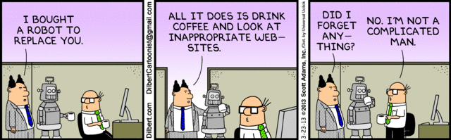
Summary
Prompt Engineering
Consequences of the session
OODA (Observe, Orient, Decide, Act)
Blue Team and Red Team implications
Carrying out Exploitations
Notes:
As we near the end of our session, let's take a moment to recap what we've covered today and discuss the consequences of these findings for the future of cybersecurity. We'll also discuss the OODA (Observe, Orient, Decide, Act) loop and its application in cybersecurity, as well as the implications of ChatGPT for both defensive (Blue Team) and offensive (Red Team) cybersecurity professionals.

Slide 19
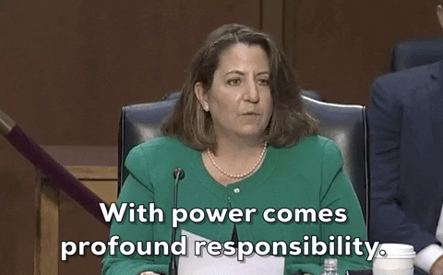
Wrap Up
Current state of AI in cybersecurity
Future predictions: constant improvement
Use your powers for good
Notes:
Before we wrap up, let's take a step back and reflect on the journey we've taken today. We've traced the history of cybersecurity, discussed the role of AI, and explored the current capabilities and limitations of AI in cybersecurity. Looking to the future, we predict continuous improvement in the field. As we conclude, I want to encourage all of you to use the knowledge you've gained today ethically. Remember, we're here to build defenses, not to breach them.

